Slide 1

CREDX CASE STUDY
Cover Page

Slide 2
Problem Statement:
To provide the Bank with a model which can identify and calculate the risk associated with lending to different demographics of people.
Objective:
The aim of this project is to predict the likelihood of defaulter cases that may occur in the future for new credit borrowers based on output generated from models such as: The Classification Tree, Random Forest Model and Logistic Regression Analysis on current datasets.

Slide 3
APPROACH TO SOLUTION
1. Exploratory Data Analysis
2. Classification Model
4. Support Vector Machine Model
3. Random Forest Model

Slide 4
DATA UNDERSTANDING
For this project, we have used two interrelated datasets:
credit _bureau.csv
demogs.csv
credit_bureau.csv includes:
An ID for each customer
Performance tag (shows whether or not there was a default)
Data columns related to defaulters in the 30-, 60- and 90-days bucket (DPD) in the last 6 or 12 months
Number of existing home loans for each customer record
Outstanding balance for each customer record
Number of auto loans
Total number of trades
demogs.csv includes:
An ID for each customer
Performance tag (shows whether or not there was a default)
Age
Gender
Marital Status for each applicant
Number of Dependents
Income
Education
Profession
Duration in Profession
Type of Residence
Duration in Residence

Slide 5
DATA Preprocessing
We begin the initial Data exploration process by-
Performing EDA:
Merge both datasets
Check for
null values
duplicate values
Outliers
Visualize data to understand general trends and relationships
2. Analysis Methods Used:
Logistic Regression Analysis
Random Forest
Support Vector Machine

Slide 6
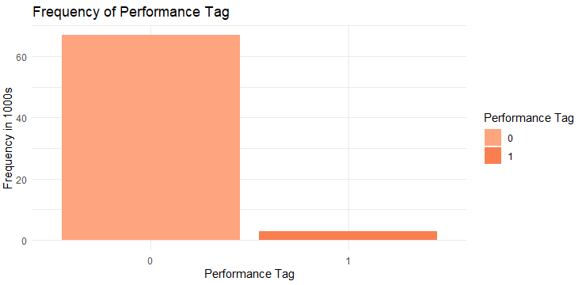
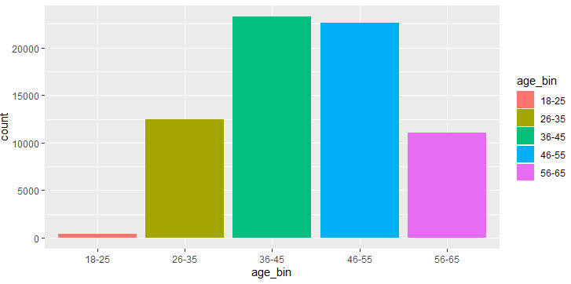
EDA-UNIVARIATE ANALYSIS
DEMOGRAPHIC DATA
An ID for each customer, Performance tag (shows whether there was a default), Age, Gender, Marital Status for each applicant, Number of Dependents , Income , Education, Profession, Duration in Profession, Type of Residence , Duration in Residence

Slide 7
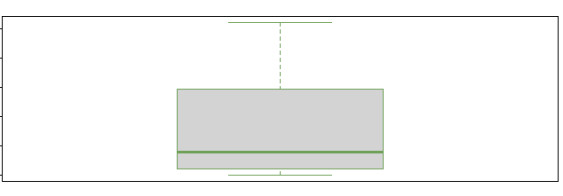
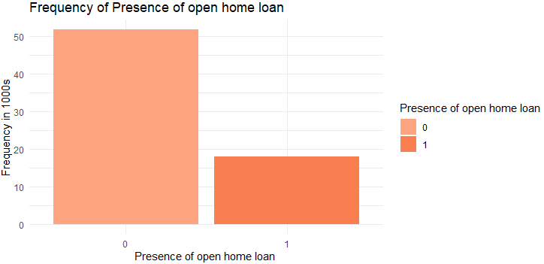
EDA-UNIVARIATE ANALYSIS
CREDIT DATA
An ID for each customer
Performance tag (shows whether or not there was a default)
Data columns related to defaulters in the 30-, 60- and 90-days bucket (DPD) in the last 6 or 12 months
Number of existing home loans for each customer record
Outstanding balance for each customer record
Number of auto loans , Total number of trades
Out Standing amount.
From the graph we can
conclude that maximum
observations are skewed
to the below average
outstanding amount which we can see
Median<Mean
Existing home
Open home
Loans :

Slide 8
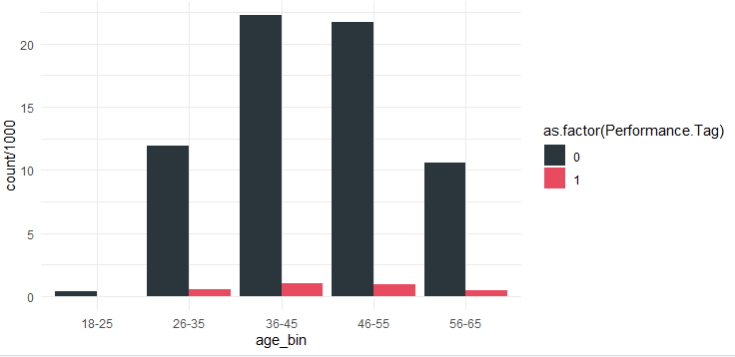
EDA-BIVARIATE ANALYSIS
DEMOGRAPHIC DATA
An ID for each customer, Performance tag (shows whether or not there was a default), Age, Gender, Marital Status for each applicant, Number of Dependents , Income , Education, Profession, Duration in Profession, Type of Residence , Duration in Residence
Conclusion: From the above plot we can conclude that default is high between 36 to 55 Age compare to Other groups but even population is also high

Slide 9
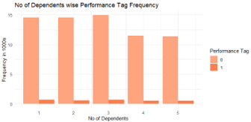
Conclusion : For Dependent 4 and 5 default rate is seen with less frequency of 12000 people.

Slide 10
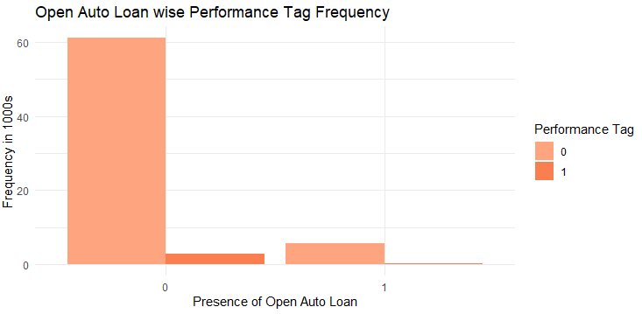
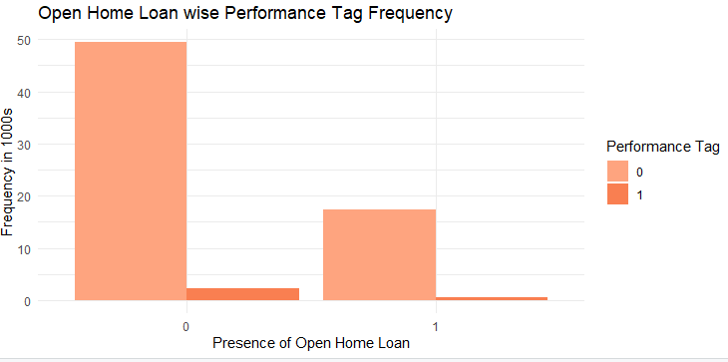
EDA-BIVARIATE ANALYSIS
CREDIT DATA
An ID for each customer
Performance tag (shows whether or not there was a default)
Data columns related to defaulters in the 30-, 60- and 90-days bucket (DPD) in the last 6 or 12 months
Number of existing home loans for each customer record
Outstanding balance for each customer record
Number of auto loans , Total number of trades

Slide 11
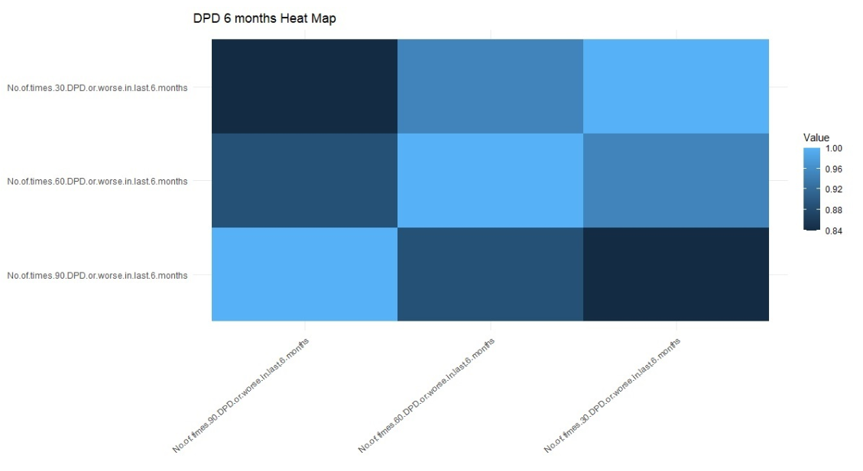
Correlation Analysis
Correlation of DPD Variables for 30, 60, 90 DPD cycle has been done
Correlation between these variable created for 6 Month DPD duration
From the above heat Map we can conclude that light blue = 1 is the relationship of variable with itself.
Dark blue color=0.84 shows the negative relationship between the variables
For 6 Months 30DPD and 60DPD average relationship.
For 6 Months 30DPD and 60DPD has significant negative relationship and more towards 0.80 value Dark Blue
30 DPD
60 DPD
90 DPD
90 DPD
60 DPD
30 DPD

Slide 12
MODEL BUILDING
OUTLIER TREATMENT:
DATA SPLIT:
DATA SAMPLING:
The given data is highly imbalanced.
You can sample data using ROSE package for balancing the training data sets.
Choose the cutoff value for the probability of default such that model evaluation metrics like accuracy ,sensitivity and specificity were almost similar.

Slide 13
LOGISTIC REGRESSION
Important Predictors & Model Statistics:
#Income 0.02289 *
#No.of.months.in.current.residence 0.01830 *
#No.of.months.in.current.company 0.01102 *
#No.of.times.90.DPD.or.worse.in.last.6.months 0.22974
#No.of.times.60.DPD.or.worse.in.last.6.months 0.13270
#No.of.times.30.DPD.or.worse.in.last.6.months 0.03471 *
#No.of.times.90.DPD.or.worse.in.last.12.months 0.00316 **
#No.of.times.30.DPD.or.worse.in.last.12.months 0.20019
#Avgas.CC.Utilization.in.last.12.months < 2e-16 ***
#No.of.trades.opened.in.last.12.months 0.36228
#No.of.PL.trades.opened.in.last.6.months 0.12740
#No.of.PL.trades.opened.in.last.12.months 0.00433 **
#No.of.Inquiries.in.last.6.months..excluding.home...auto.loans. 0.06521 .
#No.of.Inquiries.in.last.12.months..excluding.home...auto.loans. 1.61e-05 ***
#Presence.of.open.home.loan1 0.21915
#Outstanding.Balance 0.19399
#Total.No.of.Trades 0.11014
#Presence.of.open.auto.loan1 0.50095
Confusion Matrix
x tp fn fp tn acc sens spec
1 3 6230 7154 117 487 0.4801973 0.9815661 0.06373511
2 5 9400 3984 303 301 0.6935230 0.9687725 0.07024504
3 10 12925 459 555 49 0.9275093 0.9588279 0.09645669
4 15 13336 48 599 5 0.9537461 0.9570147 0.09433962
5 20 13374 10 604 0 0.9561052 0.9567892 0.00000000
6 30 13383 1 604 0 0.9567486 0.9568170 0.00000000
7 40 13384 0 604 0 0.9568201 0.9568201 NaN
8 50 13384 0 604 0 0.9568201 0.9568201 NaN
Statistics | Values
Cut-off | 0.1
Accuracy | 92.7%
Sensitivity | 95.9%
Specificity | 9.6%

Slide 14
RANDOM FOREST
Random Forest was predicting non-default for all test set data, so we created a train set using 80% of the defaults (2340 rows) and 5 % of the non-defaults (3339 rows).
Model was tuned with the following parameters:
Mtry = 2, 4, 6, 8, 10, 12, 14, 16, 18, 20
Nodesize = 3, 5, 7
Samp size = 70% or 80%
Statistics | Values
Cut-off | 0.58
Accuracy | 38.3%
Sensitivity | 38.3%
Specificity | 39.5%

Slide 15
Support Vector Machine
Support Vector Machines are sturggling to run on my computer
Dataset redced significantly, 5% of nondefaults, 80% of defaults
Linear and radial kernels were run, linear results were better, so they are communicated below
Polynomial kernels were not able to compute on my machine
Tuning was not able to compute on my machine
Oveerall, results are not as good as Random Forest
Statistics | Values
Cut-off | default
Accuracy | 83.3%
Sensitivity | 83.8%
Specificity | 30.0%

Slide 16
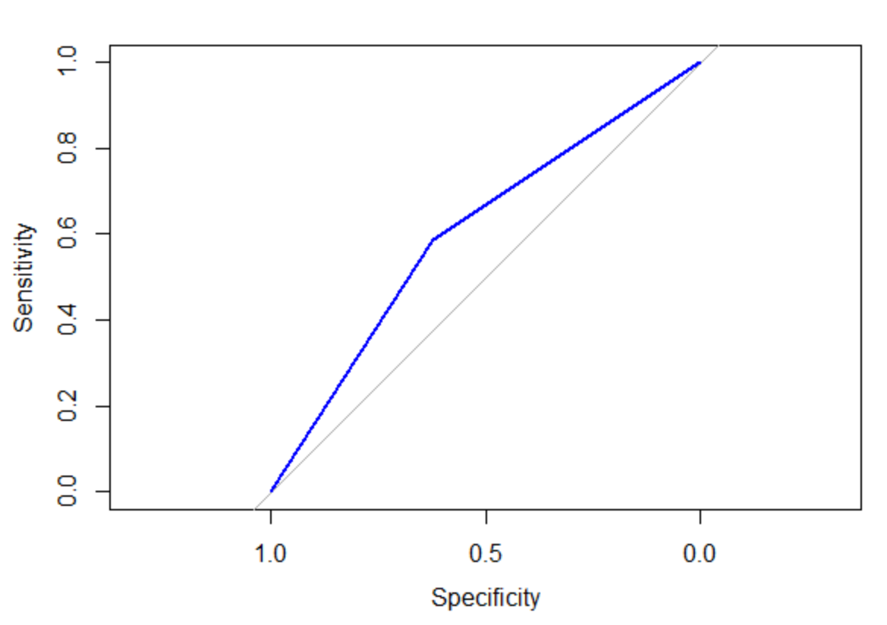
Comparison of Models
ROC Curve for final model: The Random Forest model shows the most promise, though the accuracy is still not great
AUC = 0.606

Slide 17
Conclusion
There remain significant concerns with the modellign accuracy and the tools with which we have to analyze the data are limited.
SVM analysis isn't really possible with the dataset. The Random Forest Dataset gave the most promise, though the accuracy is still quite low with only 39% for specificity and sensitivity.

